Slide 1

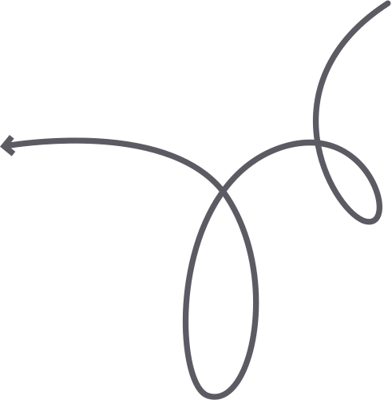




BOOK Summary
ATOMIC
HABITS
ATOMIC
Habits
Discover the Simple Habits That Will Change Your Life
READ TODAY

Slide 2

Atomic Habits is a book by James Clear that teaches you how to make small changes in your life that can lead to big results.
It's about making tiny changes that will compound over time and create massive results.
In this book summary, I will share the main insights from the four chapters of Atomic Habits by James Clear, a bestselling author and expert on habit formation.
ATOMIC Habits Summary

Slide 3
Atomic Habits are small(molecular) habits that can lead to big results. It's not necessary to make big changes in your life to get big results. You can make small changes that will compound over time and create massive results. Making 1% improvement every day will lead to 37x improvement in a year. It's about making tiny changes that will compound over time and create massive results.
When you work out for 1 hour, you don't see any results. But when you work workout for 1 hour every day for 1 year, you will see massive results. similarly, when you eat junk food for 1 day, you don't see any results. But when you eat junk food every day for 1 year, you will see massive results.
ATOMIC Habits Summary

Slide 4
The Aggregation of Marginal Gains
ATOMIC Habits Summary

Slide 5
The Aggregation of Marginal Gains is the strategy of making small improvements in many different areas of your goals to make a big difference in the overall results. Tiny changes in the process can lead to big changes in the results.
ATOMIC Habits Summary

Slide 6
Goals Vs System
ATOMIC Habits Summary

Slide 7
According to James Clear, Goals are about the results you want to achieve. Systems are about the processes that lead to those results. Goals are good for setting a direction, but systems are best for making progress.
Getting 1 million subscribers is a goal. Posting 1 video every day is a system. Similarly, losing 10 kg is a goal. Eating healthy food every day is a system.
ATOMIC Habits Summary

Slide 8
Goals are best for direction but systems are best for making progress. Winners and losers have the same goals but what makes winners different from losers is their systems. Set the goals but focus on the systems and processes that will lead to those goals.
ATOMIC Habits Summary

Slide 9
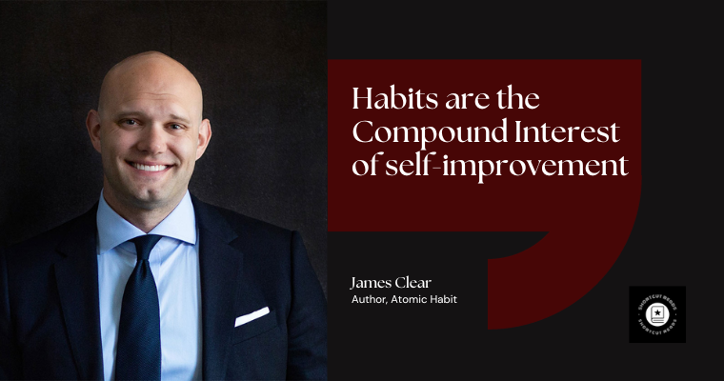

Slide 10
The Four Rules of Behaviour Change
  Make the cue obvious
  Make the craving attractive
  Make the response easy
  And the reward satisfying
ATOMIC Habits Summary

Slide 11
Make The Cue Obvious
ATOMIC Habits Summary

Slide 12
The first rule of behaviour is to make the cue obvious. Visibility and clarity trigger the cues that lead to habits. If you want to make a habit, you need to make it visible, clear and obvious or if you want to break the bad habit, you need to make it invisible, and unobvious.
The environment is also a cue that can trigger a habit. If you want to eat healthy food, you can change your environment by replacing junk food with healthy food. If you want to read a book, you can change your environment by placing a book on your desk and removing all the distractions. So, the environment is also a cue that can trigger a habit.
ATOMIC Habits Summary

Slide 13
Make the Craving Attractive

Slide 14
The second law of behaviour change is to make it attractive. The more attractive an opportunity is, the more chances that you will adapt it in your life. By making a habit attractive, you can expect a rewarding experience that will make you want to repeat it again and again.
ATOMIC Habits Summary

Slide 15
ATOMIC Habits Summary
Make the Response Easy

Slide 16
you don't want the habit itself, you want the outcome of the habit. The more difficult the task is the more chances to give up. So, you need to make the task easy. and It's also human nature to do easy things and avoid hard things. The human brain always wants to save energy. So I always try to do the easy task. If you want to adopt a habit in your life, you need to make it easy and the opposite if you want to break a bad habit, you need to make it hard.
ATOMIC Habits Summary

Slide 17
Make the Reward Satisfying

Slide 18
The fourth law of behaviour change is to make it satisfying. The more satisfying an experience is, the more chances that you will adapt it in your life. By making a habit satisfying, you can expect a rewarding experience that will make you want to repeat it again and again.
ATOMIC Habits Summary

Slide 19
Conclusion
ATOMIC Habits Summary

Slide 20
I will recommend this book to people who often struggle with making changes in their lives. It's a great book for anyone who wants to improve themselves and live a happier life.
Weathers you are a college student, a working professional or a business owner, this book will help you achieve your goals and understand your life better.
ATOMIC Habits Summary

Slide 21

Buy It on Amazon
ATOMIC Habits Summary

Slide 22
Thanks
ATOMIC Habits Summary
Presentation by The www.shortcutreads.com

